Slide 1
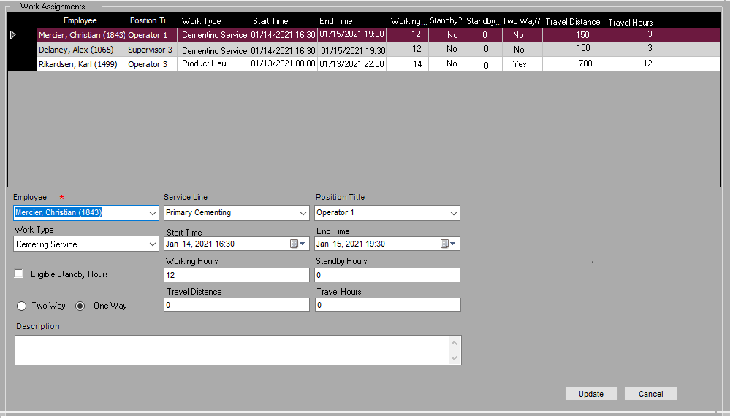
Supervisor
Same as current process
Sup ensures crew are entered and information is accurate
Position will be accurate with VP positions
Should we default of make pick
Some changed fields
Added
Work Type
Work hours
Enable Standby Hours
Two Way (Check box)
Removed
MBA/MTS
MTS Number
Shift
Product Haul (Check box)
Extended Travel (Check box)
Added flexibility for 1 or 2 way travel
2 way – product haul
1 way – extended travel
Service Line – Remove/Hide and link to Job Type SL
Does Sup need to Job Bonus Printout??

Slide 2
Manager
Manager can correct and approve the facts within job approval process.
This information will generate the Variable Pay entries
Same interface as Supervisor

Slide 3
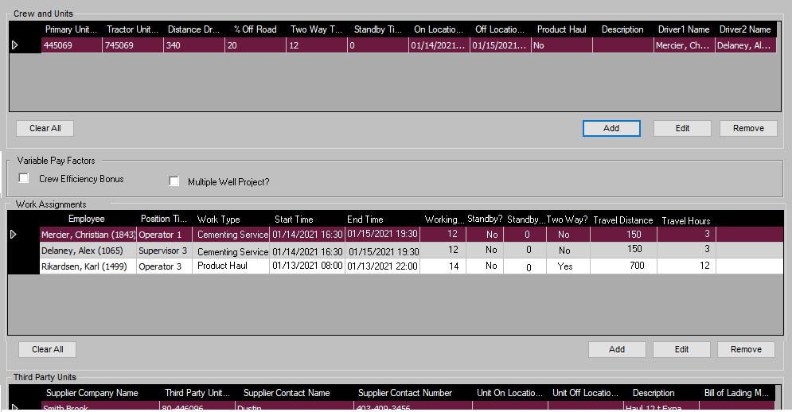
Manager
Manager has ability to indicate Crew Efficiency Bonus, and Pay entry will be automatically added to VP If only 2 people on job
Multi-Well Project
Flag to indicate multi-well
Not sure how to automate this yet
keep as manual entry VP for now as happens rarely

Slide 4
Variable Pay Entry Online Interface
Add
Modify
Approve
Delete
Filters: District:
Brooks
Service Line:
Primary
Employee:
Mercier, Christian
 | Employee Name | Ticket # | Service Line | Revenue | Position | Work Type | Area | Pay Type | Pay Amount | Work Activity | Status | Description
 | Mercier, Christian | 463953 | Primary | $20,000 | Operator 1 | Cementing | W | Base Variable Pay | 370 | 123456 | Approved
 | Mercier, Christian | 463953 | Primary | $20,000 | Operator 1 | Cementing | W | Standby | 32 | 123456 | Approved
Once a work activity is approved, related pay entries will be calculated automatically based on variable pay rules. All pay entries will be available on the Pay Entry Online Interface.
DA can enter pay entry which is not automated. The entered pay entry can be approved by manager case by case.
DA can modify automatically created pay entries, flagged to be approved by manager
Approved pay entry can be modified by DA, the manager approval process will be triggered.
Pay entry can be deleted by DA, the manager approval process will be triggered.
If the pay period is cut off, all pay entries within the pay period are locked.
Pay period cannot be cut off if any pay entry is unapproved within the pay period.

Slide 5
Variable Pay Summary Online Interface
Print Employee Statement
Filters: District:
Brooks
Service Line:
Primary
Pay Period:
Jan 10, 2021 – Jan 23, 2021
Pay Period Cut Off
Approve
Employee Name | Base Variable Pay | Sum of OVPP | Standby Amount | Total Amount | Pay Entries | Status
Mercier, Christian | $997.51 | $272.40 | $40 | $1269.91 | View | Approved
Delaney, Alex | $450.00 | $100.00 | $0 | $550.00 | View | Approved
VP Summary is updated dynamically while new entries being created until the pay period is cut off.
VP Summary can be break down to list the amount of each pay type if needed.
Pay Period can only be cut off per District/Service Line by DA.
Once District pay period is cut off, all work activities and pay entries are considered pending locked. However, if anything is changed before approval, the cut off needs to be triggered again.
District Payroll Summary is approved, all work activities and pay entries within the pay period are locked.
Employee statement can be printed in batch or individually.

Slide 6
Payroll
Filters: District:
Brooks
Service Line:
All
Pay Period:
Jan 10, 2021 – Jan 23, 2021
Export
District | Service Line | Pay Period Start | Pay Period End | Total Amount | Pay Summary | Status
Brooks | Primary Cementing | Jan 10, 2021 | Jan 23, 2021 | $10,000 | View | Open
Brooks | Remedial | Jan 10, 2021 | Jan 23, 2021 | $0 | View | Open
Pay Period Summary is updated dynamically while pay period is cut off or approved.
Payroll Admin can export payroll summaries within the pay period by district/service line for ADP import purpose.
Once the Pay Period Summary is exported, the pay , all pay entries and work activities underneath are not able to re-open for modification.
Pay Period can only be re-opened by Payroll Admin to allow pay entries and work activities to be modified and re-approved.

